Slide 1


ERODE SENGUNTHAR ENGINEERING COLLEGE (An Autonomous Institution) Approved by AICTE ,New Delhi ,Permanently Affiliated to Anna University-Chennai, Accredited by National Board of Accreditation (NBA), New Delhi & National Assessment and Accreditation Council(NAAC),Bangalore with ‘A’ Grade PERUNDURAI-638 057,TAMILNADU,INDIA.
DEPARTMENT OF COMPUTER SCIENCE AND ENGINEERING
TITLE: SERVERLESS FILE SHARING PLATFORM USING AWS
BATCH NO : 16
MODAL REVIEW
TEAM MEMBERS:
MARISELVAM M(ES22CS68)
MOHAMED IRFAN M(ES22CS71)
VISHNU V(ES22CS124)
GUIDED BY:
V.THIRUMURUGAN (AP/CSE)

Slide 2
SERVERLESS FILE SHARING PLATFORM
Contents :
Abstract
Existing System
Problem Statement
Proposed System
Advantages
Flowchart
Modules
Output Screenshot
References

Slide 3
Abstract :
SERVERLESS FILE SHARING PLATFORM
The increasing demand for scalable and cost-efficient File-sharing solutions highlights the limitations of traditional platforms that rely on complex server management, high operational costs, and limited scalability.
By utilizing serverless services such as AWS Lambda, Amazon S3, API Gateway, and DynamoDB, the platform enables users to securely upload, store, and share files without worrying about infrastructure maintenance. The solution ensures automatic scalability to handle fluctuating workloads while optimizing costs by eliminating the need for manual server provisioning.
Additionally, security is implemented through AWS Cognito for user authentication and access control. The project demonstrates how a serverless architecture can provide a reliable, secure, and cost-effective filesharing platform that scales with user demand and ensures high availability, making it an ideal solution for modern businesses and developers seeking an efficient file management system.

Slide 4
SERVERLESS FILE SHARING PLATFORM
Existing System:
On-Premise or Traditional File Sharing
Files are stored on physical servers or virtual machines.
Requires manual management of infrastructure.
Commonly uses FTP, SMB, or local shared drives.
Authentication is managed using in-house systems or basic access controls.
Limited or no scalability.
High maintenance cost and low fault tolerance.
Limitations :
Scalability: Cannot handle sudden traffic spikes.
Availability: Single points of failure lead to downtime.
Security: Often lacks granular access control, encryption, or logging.
Cost: High operational cost due to infrastructure and manpower.

Slide 5
SERVERLESS FILE SHARING PLATFORM
Problem Statement:
Traditional file-sharing platforms face significant challenges related to scalability, infrastructure management, and cost efficiency. These systems require complex server maintenance, leading to high operational costs and limited scalability when handling fluctuating workloads. Additionally, ensuring secure access control and data management remains a concern, especially with increasing user demands for seamless and reliable file-sharing solutions

Slide 6
SERVERLESS FILE SHARING PLATFORM
Proposed System:
A modern, cloud-native, serverless file-sharing platform built with AWS services.
Architecture & Key AWS Services:
Amazon S3 – To store files securely and durably.
Amazon API Gateway – To expose APIs for uploading/downloading files.
AWS Lambda – Backend logic for file handling (upload, download, delete, generate shareable links).
Amazon Cognito – User authentication and access control.
AWS DynamoDB – Store metadata (file names, owners, timestamps, permissions).
Amazon CloudFront – CDN for fast and secure file delivery.
S3 Pre-signed URLs – For time-bound access to files.
AWS IAM – Role-based access control for resources.

Slide 7
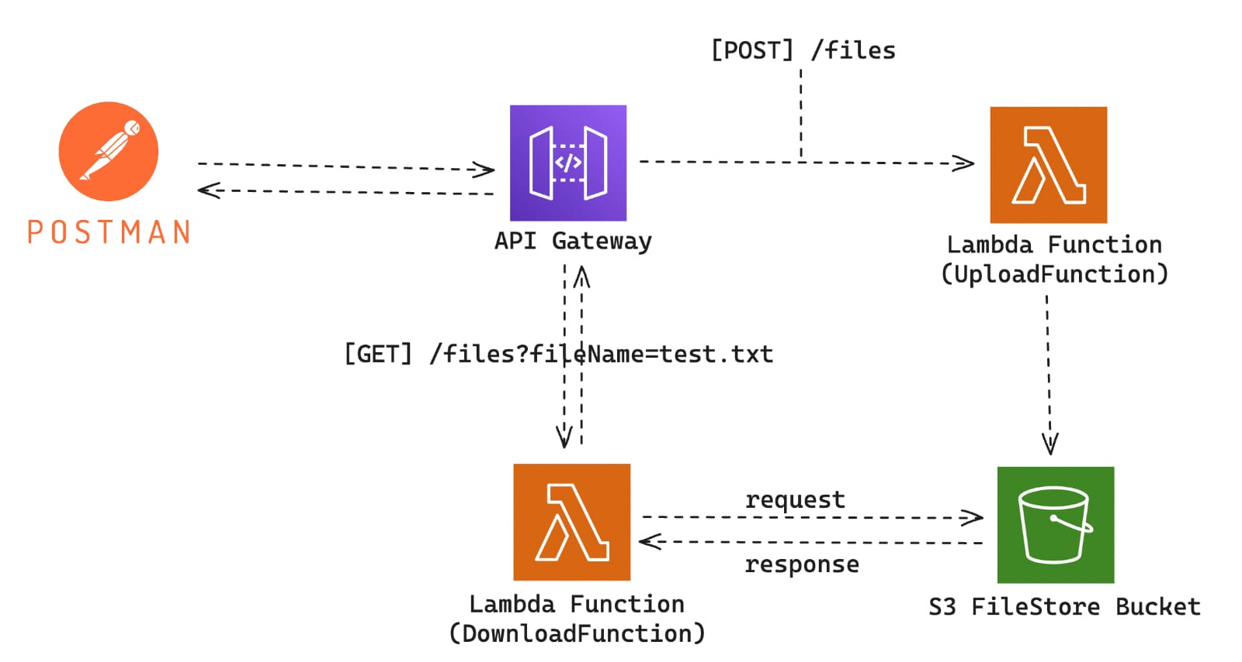
SERVERLESS FILE SHARING PLATFORM
FLOW DIAGRAM :

Slide 8
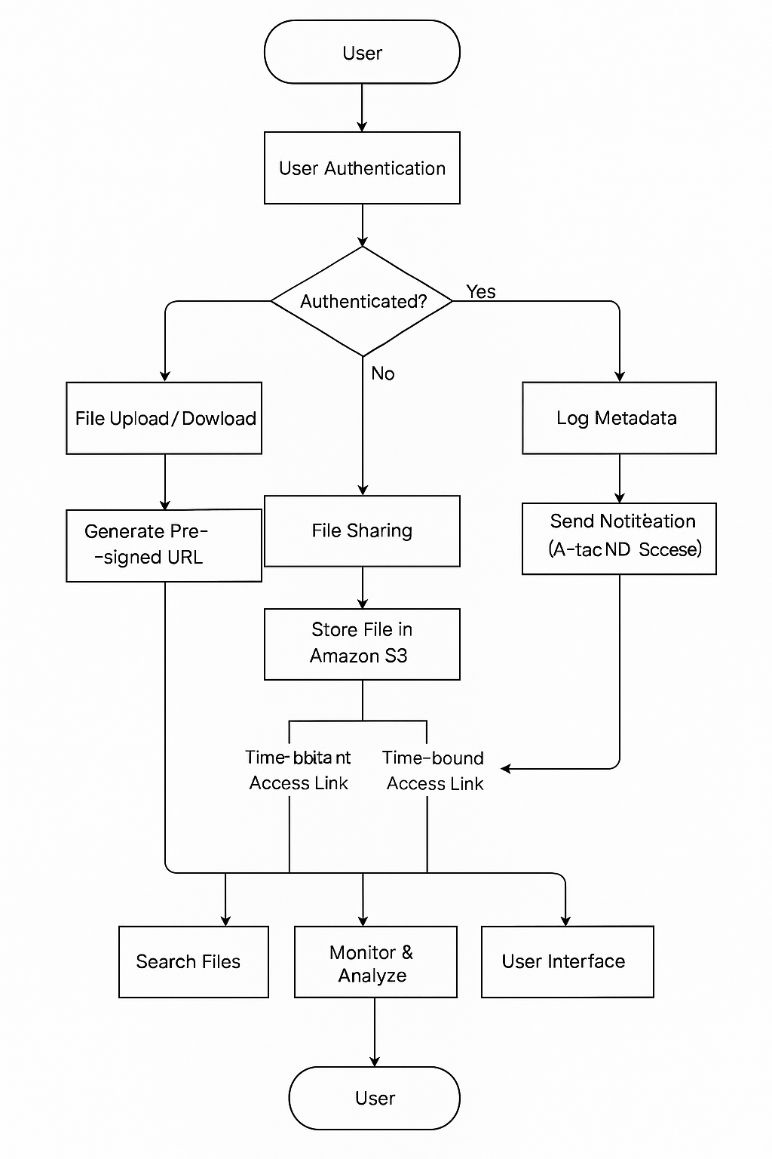
SERVERLESS FILE SHARING PLATFORM
Flowchart:

Slide 9
SERVERLESS FILE SHARING PLATFORM
Advantages:
Scalable – Handles millions of file transfers without server provisioning
Cost-effective – Pay-per-use pricing model; no idle infrastructure cost
Highly available – Backed by AWS’s global infrastructure
Secure – Built-in encryption, access control, and monitoring
Low maintenance – No servers to manage or patch
Fast deployment – CloudFormation for Infrastructure as Code (IaC)

Slide 10
SERVERLESS FILE SHARING PLATFORM
Modules:
Module 1: User Authentication System
Module 2: File Management Module
Module 3: File Sharing Module
Module 4: Metadata & Search Module
Module 5: Notification Module
Module 6: Admin & Analytics Module

Slide 11
SERVERLESS FILE SHARING PLATFORM
MODULE 1: User Management Module
Objective: Handle user registration, login, and role-based access
Features:
Sign up/login using Cognito
Assign user roles (admin, standard)
MODULE 2: File Management Module
Objective: Allow users to upload, download,delete and manage files
Features:
Upload files to S3 via Lambda
Generate pre-signed URLs for secure downloads
Delete and rename files
List user files with metadata

Slide 12
SERVERLESS FILE SHARING PLATFORM
MODULE 3: File Sharing Module
Objective: Enable time-bound and access-restricted sharing.
Features:
Generate sharing links (valid for X minutes)
Limit number of downloads
Optional password protection for shared links
MODULE 4: Metadata & Search Module
Objective: Track file-related info and allow quick access
Features:
Store file metadata (owner, size, type, timestamp) in DynamoDB
Search by filename, type, date, etc.

Slide 13
SERVERLESS FILE SHARING PLATFORM
MODULE 5: Notification Module
Objective: Alert users about file uploads, downloads, or shares
Features:
Use SNS to send email notifications
Optional SMS alerts
Real-time frontend notifications (API Gateway)
MODULE 6: Admin & Analytics Module
Objective: Allow admin to monitor and analyze platform usage
Features:
CloudWatch metrics (file uploads, traffic, errors)
List all users and their activity
File storage statistics

Slide 14
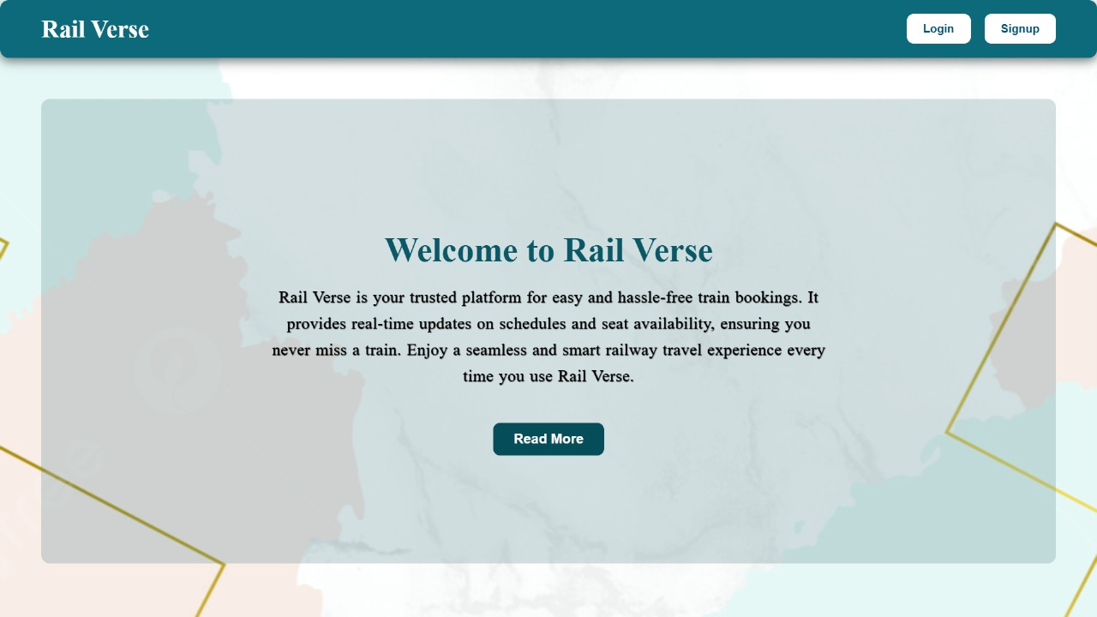
SERVERLESS FILE SHARING PLATFORM

Slide 15
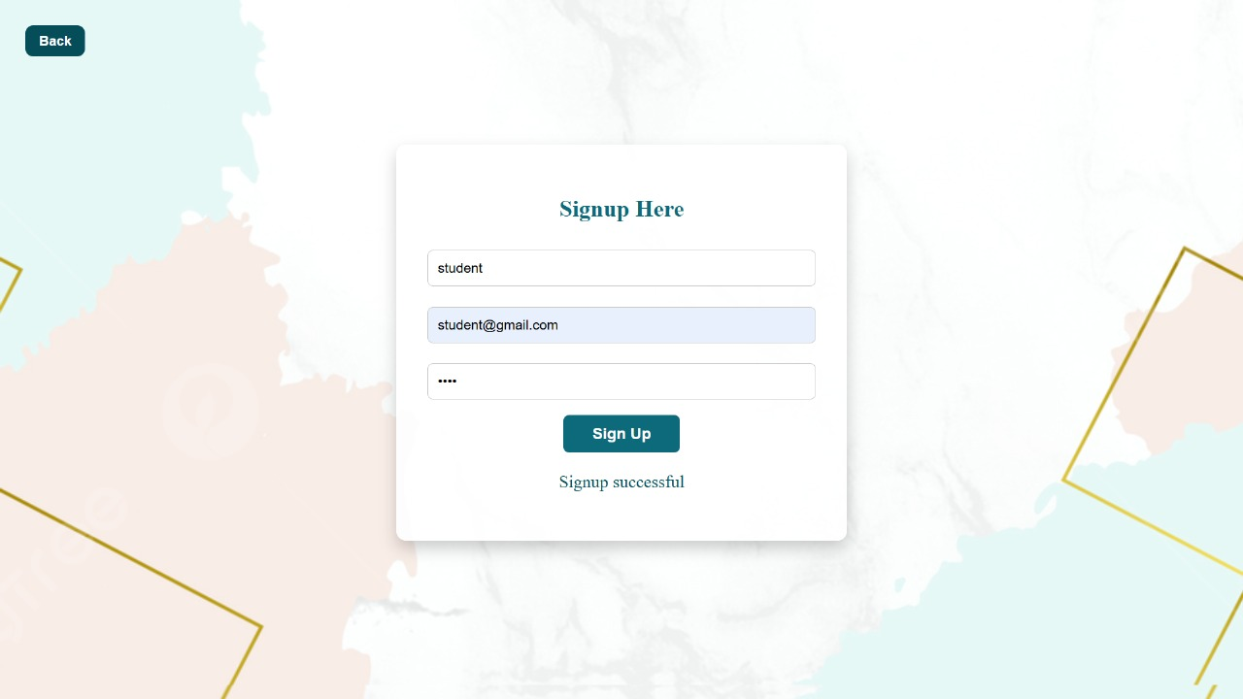
SERVERLESS FILE SHARING PLATFORM

Slide 16
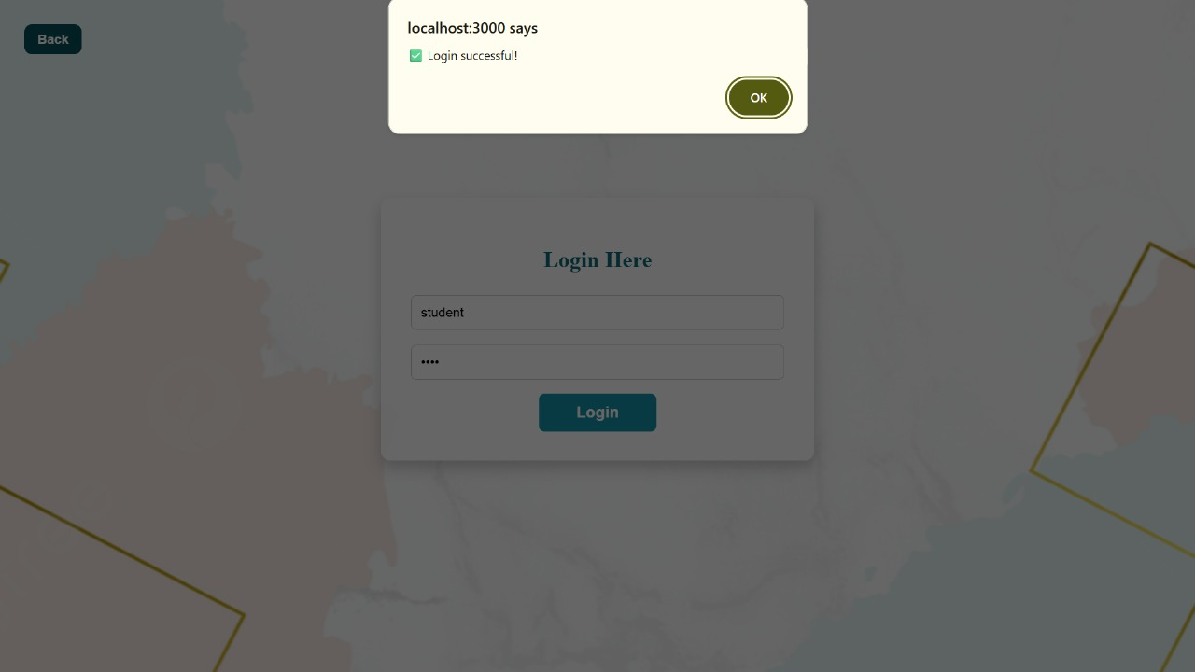
SERVERLESS FILE SHARING PLATFORM

Slide 17
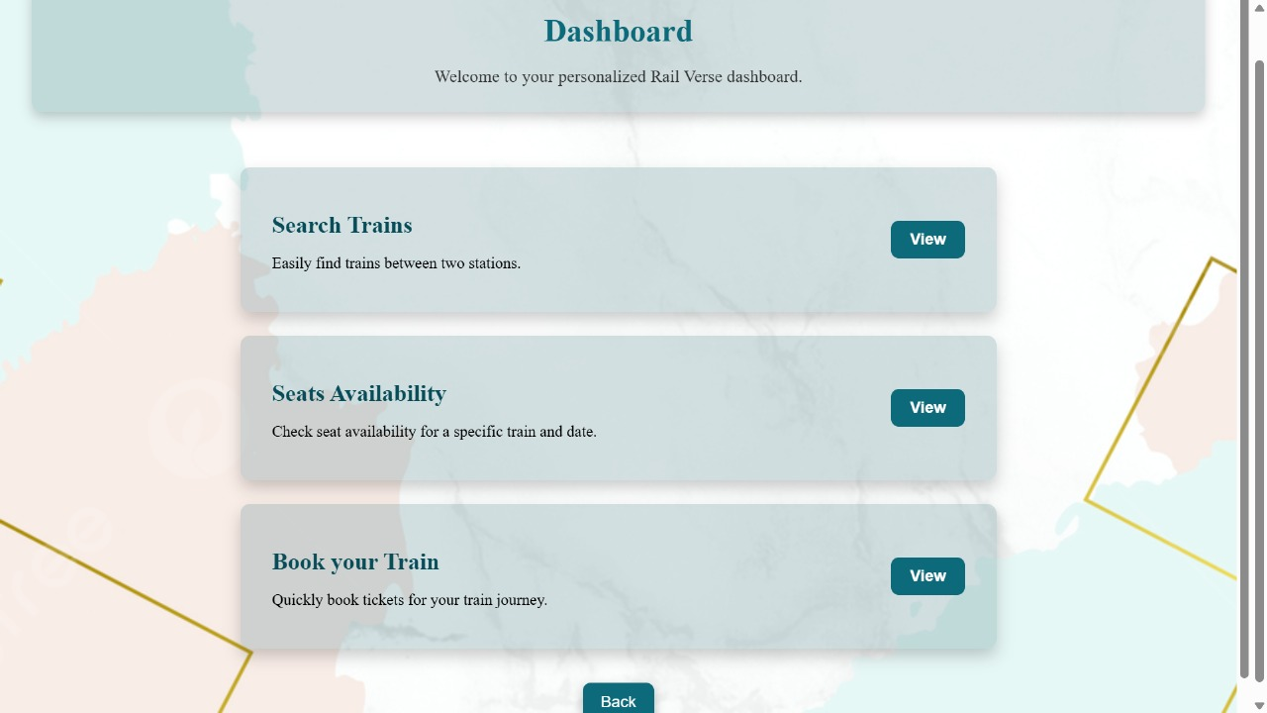
Smart Railway Information System Output Screenshot

Slide 18
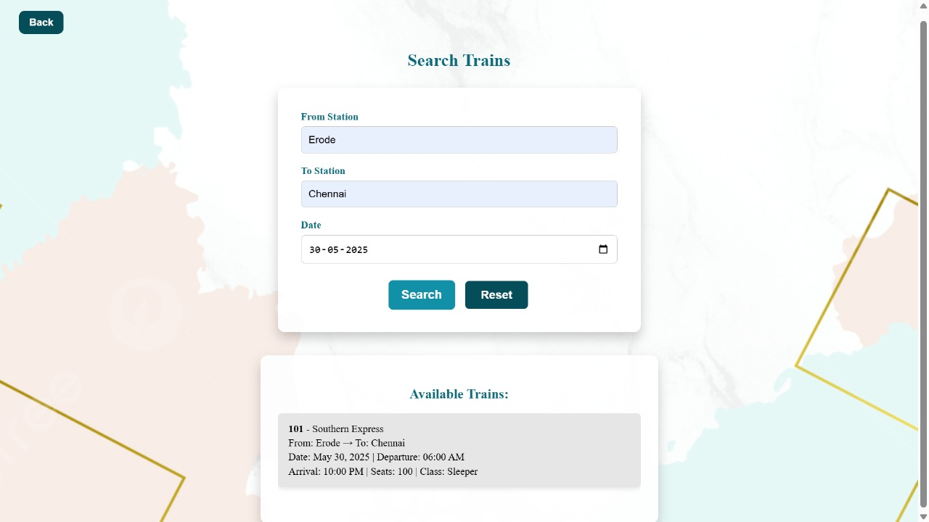
Smart Railway Information System Output Screenshot

Slide 19
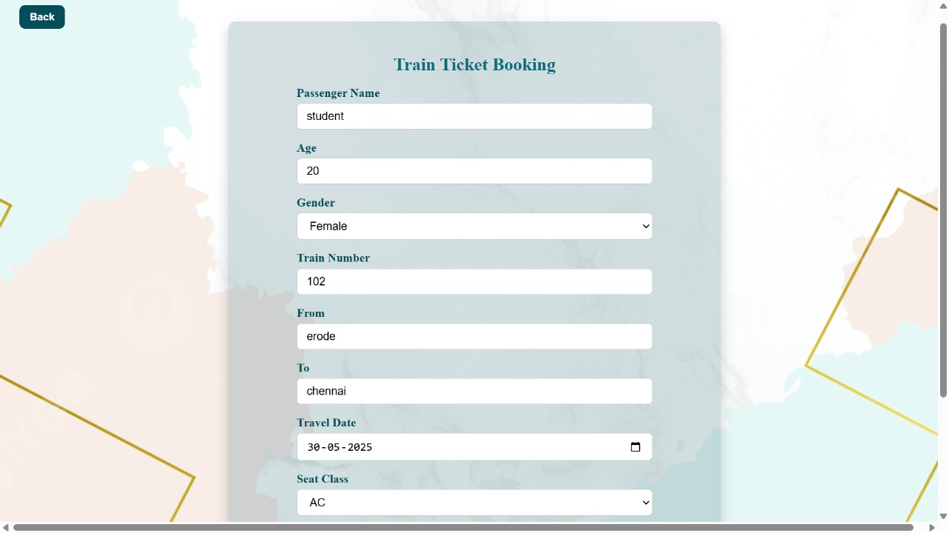
Smart Railway Information System Output Screenshot

Slide 20
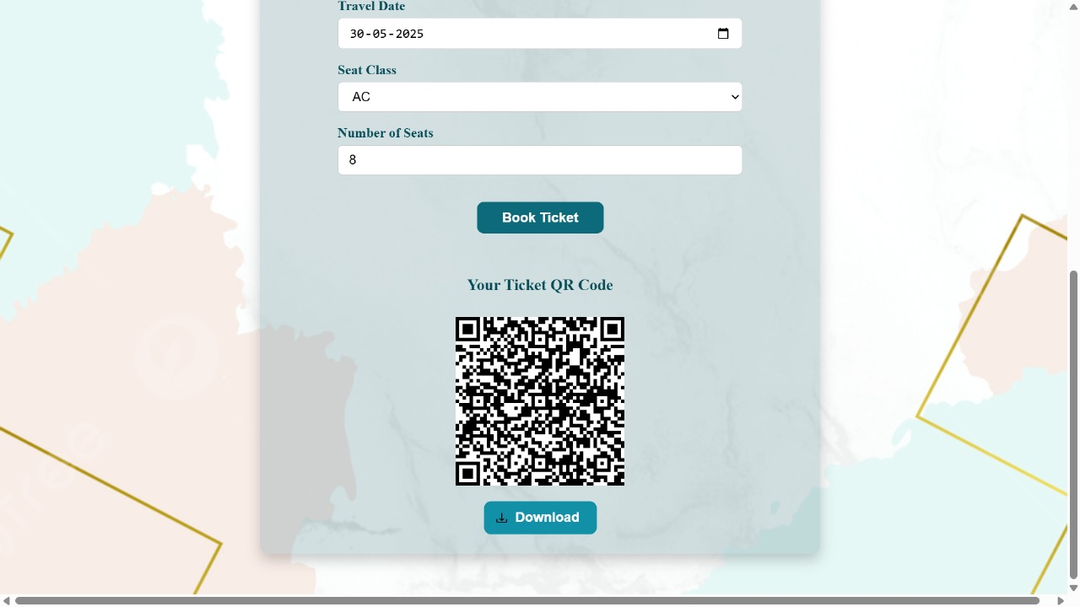
Smart Railway Information System Output Screenshot

Slide 21
SERVERLESS FILE SHARING PLATFORM
References:
Silva, M.N. and Carvalho, M. (2018) Implementation and analysis of a serverless shared drive with AWS Lambda. Proc. Int. Conf. Convergence Technol. (I2CT), 4, 1–5.
Schleier-Smith, J., Holz, L., Pemberton, N. and Hellerstein, J.M. (2020) A FaaS file system for serverless computing. Proc. ACM SIGOPS, Preprint, arXiv:2009.09845.
Zhang, J., Wang, A., Ma, X., Carver, B., Newman, N.J., Anwar, A., Rupprecht, L., Skourtis, D., Tarasov, V., Yan, F. and Cheng, Y. (2022) InfiniStore: Elastic serverless cloud storage. IEEE Trans. Cloud Comput., Preprint, arXiv:2209.01496.
Juve, G., Deelman, E., Vahi, K., Mehta, G., Berriman, B., Berman, B.P. and Maechling, P. (2010) Data sharing options for loud Compute., 1–8.

Slide 22
SERVERLESS FILE SHARING PLATFORM
Das, A., Imai, S., Wittie, M.P. and Patterson, S. (2020) Performance optimization for edge-cloud serverless platforms via dynamic task placement. Proc. IEEE/ACM Int. Symp. Edge Comput., Preprint, arXiv:2003.01310.
Pelle, I., Czentye, J., Dóka, J. and Sonkoly, B. (2020) Dynamic latency control of serverless applications operated on AWS Lambda and Greengrass. Proc. ACM SIGCOMM, Poster Session.
Ortiz, A. (2019) Architecting serverless microservices on the cloud with AWS. Proc. 50th ACM Tech. Symp. Computer Sci. Educ. (SIGCSE), 1275–1275.
Rinta-Jaskari, E., Allen, C., Meghla, T. and Taibi, D. (2022) Testing approaches and tools for AWS Lambda serverless-based applications. Proc. IEEE PerCom Workshops, 286–291.

Slide 23
THANK YOU!!!

